Slide 1

Treet
Company 4

Slide 2
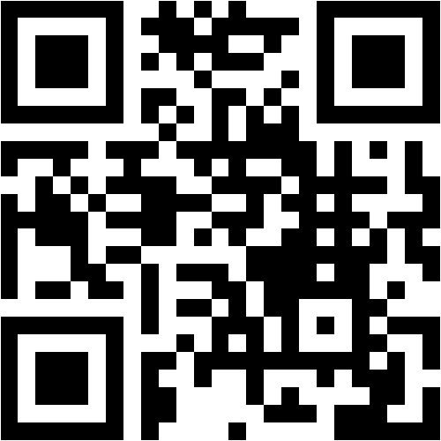
Agenda
For Questions: Follow the link in the chat or the QR and write questions during the presentation.
Company presentation
RÖ:s business challenges
Our solution
Case
Description of the different views in our product
Future
Notes:
https://www.menti.com/t5hcfhbehi
Menti.com
72 04 52 5

Slide 3
Company presentation
Company 4
25 people
Presenting today: Project manager, strategic product manager

Slide 4
business challenge
How can we make our patients continue measuring?
Notes:
In September Region Östergötland told us about 4 business challenges they are facing in their self-monitoring project. The one we chose to work with was the one about how to keep the patients measuring. At the tollgate meeting, we presented how we wanted to solve that problem and the idea we presented was a gamification product, and our solution was to introduce multiple game elements which are going to incentivize the patient’s to continue measure up. Today we have the product ready, to treat both your and your patients problems, and the solution is:

Slide 5
Our solution
Notes:
Treat, our gamification solution to your problem. It is an application with game elements that is going to change the patient’s attitude towards the self-monitoring from HAVE TO, to WANT TO. It is an app where the patient get streaks, grow trees and competes with themselves to have the most beautiful forest. This we want to show to you by an example of a patient and user of the system.

Slide 6
Case
Patient Anders is diagnosed with diabetes
The doctor at RÖ wants to monitor the patient’s blood-sugar and daily activity
The doctor therefore adds the patient to Treet - the self monitoring app
Notes:
Now we re going to show a scenario where the patient logs in to treet, check goals, achievements and the forest. Then the patient measures the blood pressure and register the data in the application. Thereafter we show the patients new tree. We also show how the patient can change gamification level in the app

Slide 7
Treet

Slide 8
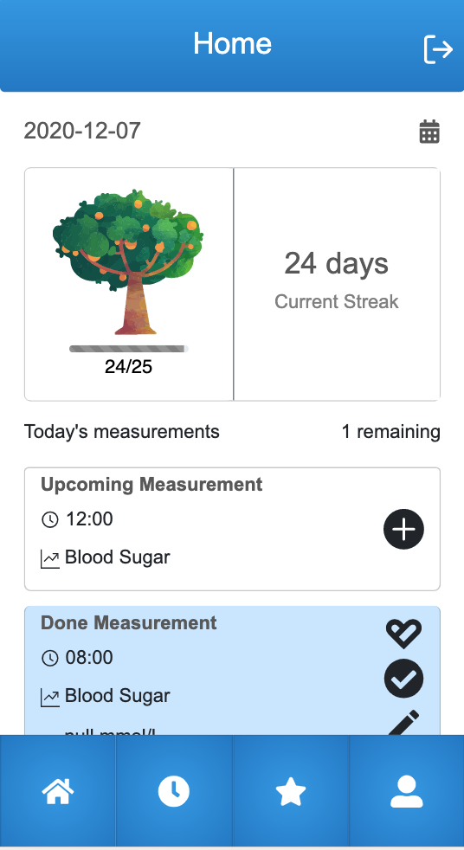
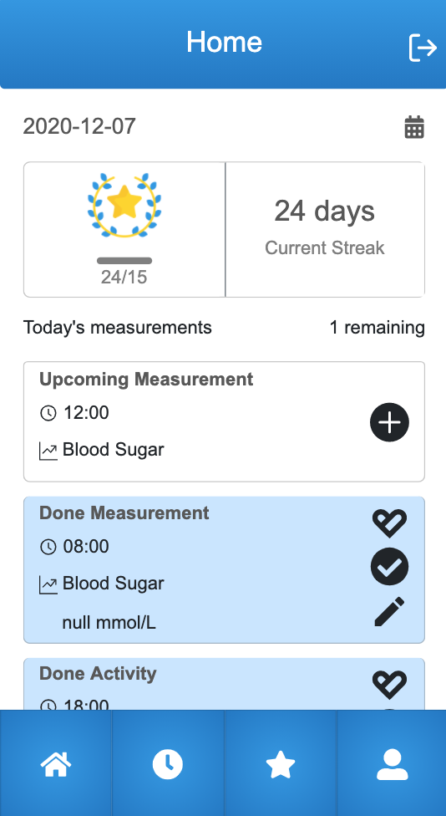
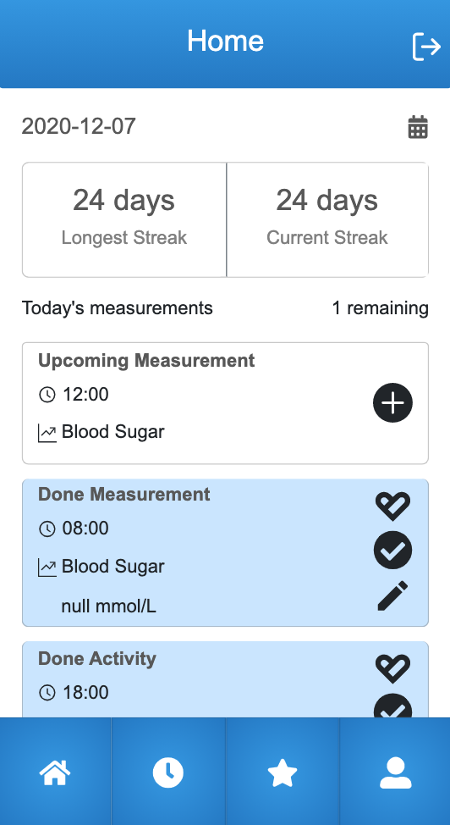
Home-page
Notes:
Now we are going to go through the different views in our product. To start with we have the Home-page. At the home-page in Treet, the patient can see different things depending on which gamification-level the patient has chosen. The thing that alters between the different levels is if the patient is shown a tree, achievement or the longest streak. Furthermore the patient is shown their current streak, which measurements they have to take and when the patient is supposed to do the measurement. The app also shows measurements that are done, indicated by a blue colour as you can see in the pictures.

Slide 9
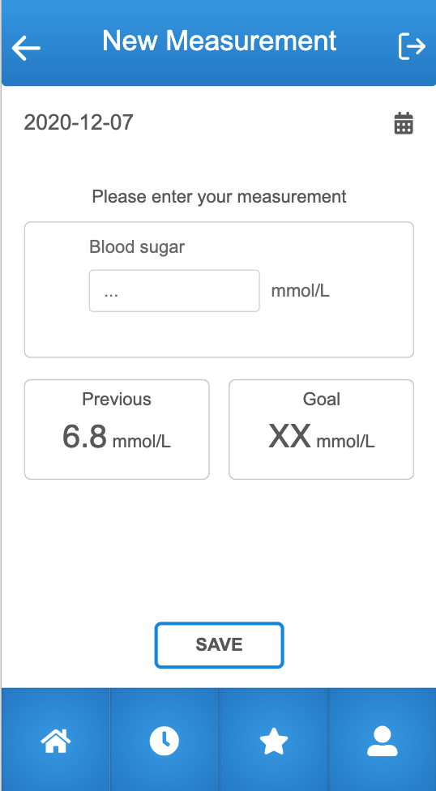
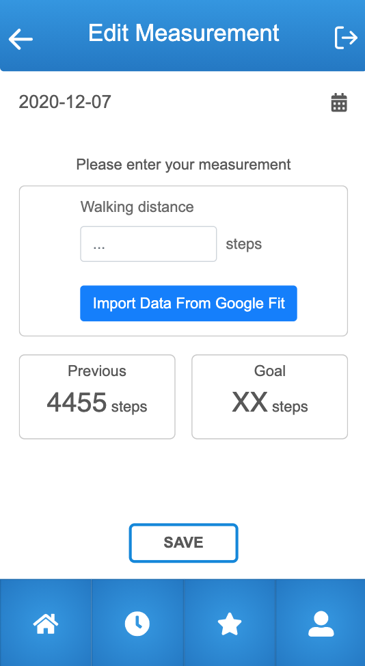
Measurements
Notes:
Then we have the views for measurements. In Treet the patient can register new and edit previous measurements. In today’s product the patient is able to register blood sugar and activity. Blood sugar is showed by the left picture which is the view the patient reaches when the patient wants to add a new measurement. In the right picture you can see the view the patient sees when he/she wants to edit a previous activity. You can see a button with the text Import from GoogleFit which is a possibility for the patient when registering activities. We think that the usage of GoogleFit can make the registering easier and because of that make the patient more likely to use our product.

Slide 10
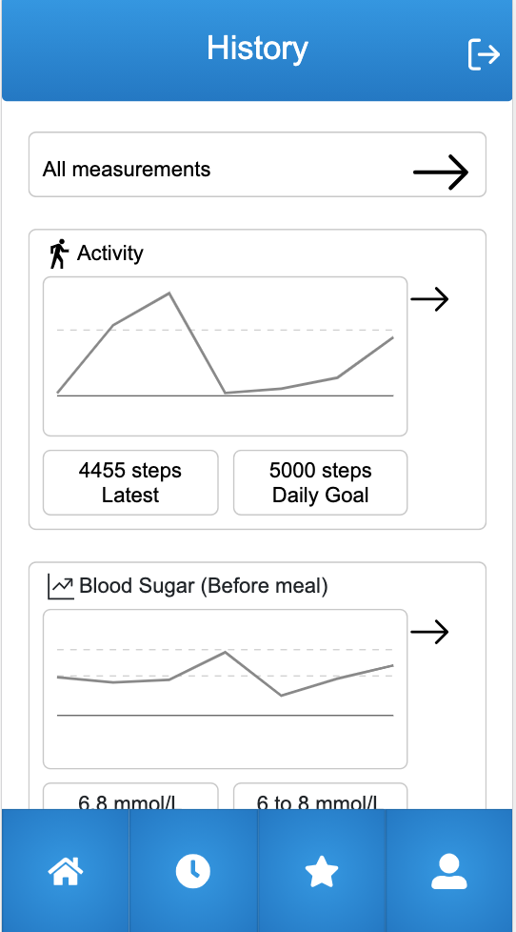
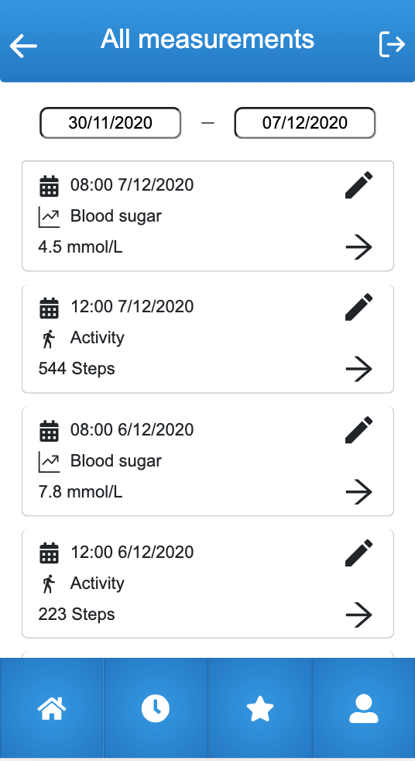
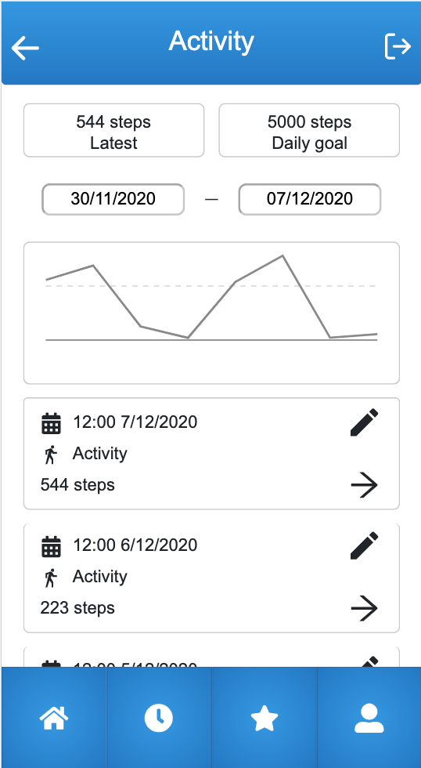
History
Notes:
Next up, we have the History-view where the patient can view history and progress. These pictures shows three views that are related to that. In the history-view the patient is able to see graphs over their activity and blood sugar. They are also able to click on the graph to get the activities and the possibility to change time-intervals In the graphs. From the History-view the patients can also reach all their measurements.
The graphs in our product are not fully implemented yet, because the data in the graphs is not fetched from OpenEHR. However, we have implemented the graphs so that it is easy to change the data from mocked data to the actual patient data.

Slide 11
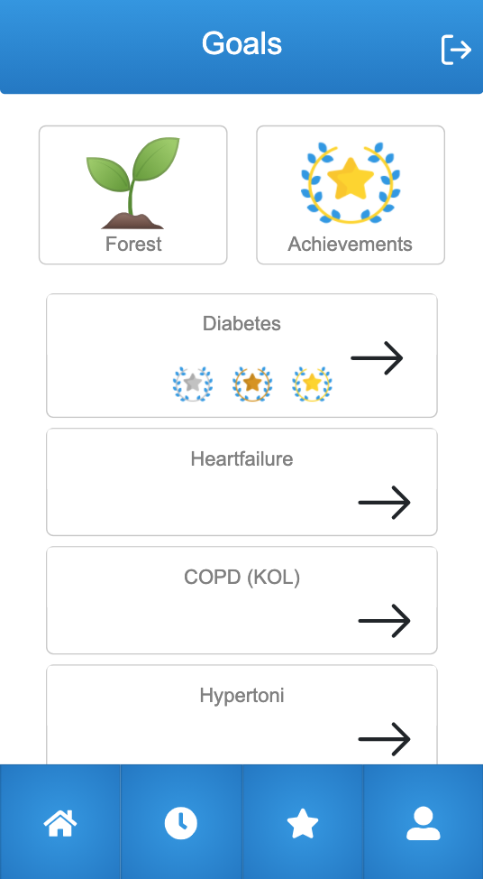
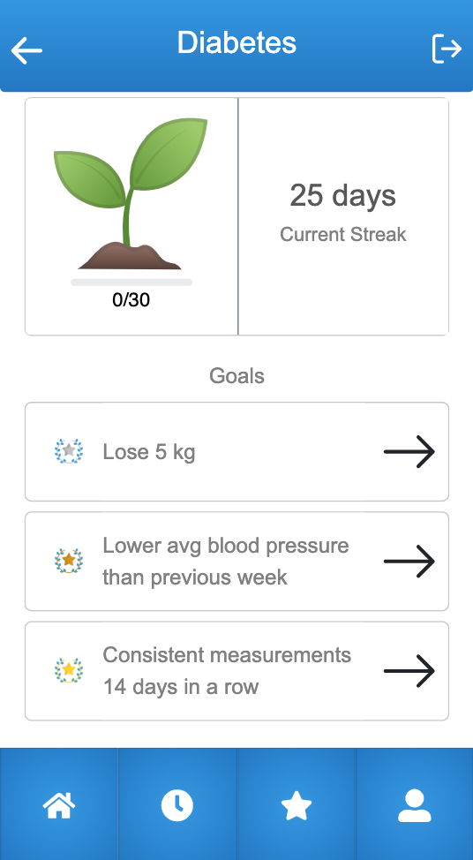
Goals
Notes:
In the Goals view, the patient can reach pages for the disease, the patient’s forest and achievements. In this version of our product we have only implemented Diabetes. But in the future other diseases can be added so that Treet can have support for patients with other diseases than diabetes as well as patients with multiple diseases. We have also implemented a view for the disease where we want to show goals for the patients. As of now the goals are static, but in the future we want the goals to be set by medical professionals.

Slide 12
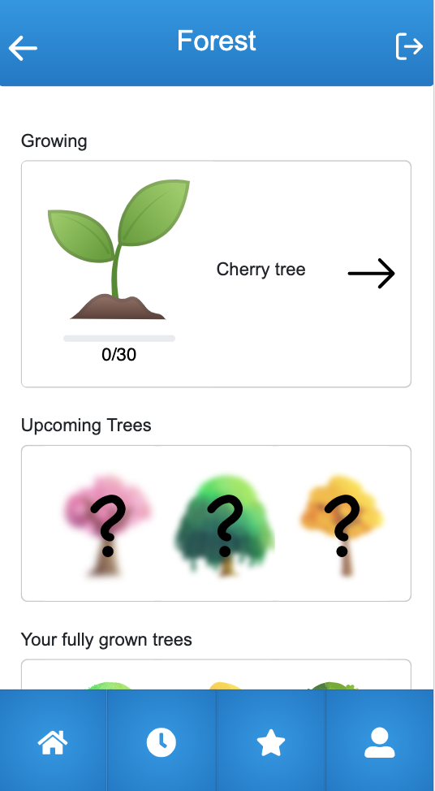
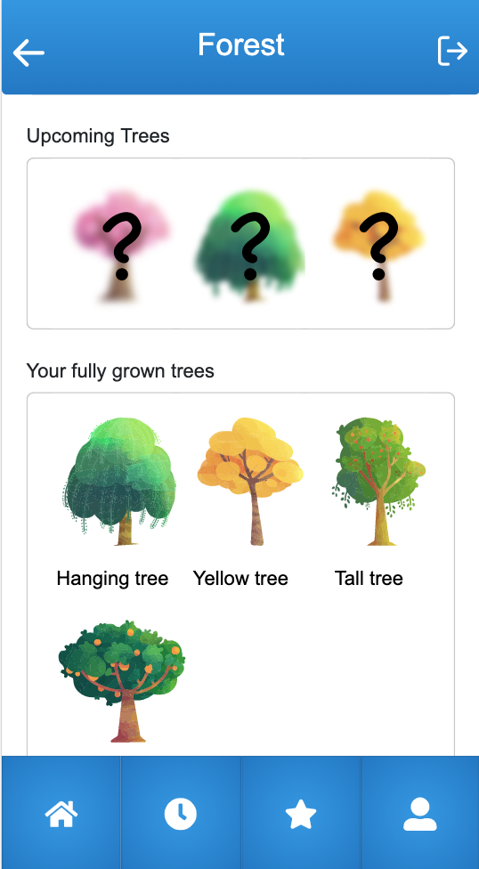
The forest
Notes:
On to the forest view, which is the view where the patient can view their fully grown trees, see upcoming trees and their growing tree. The patient’s trees grow with the patient’s streak, and when the the tree is fully grown, the tree moves to the box with fully grown trees and the patient gets a new tree to grow. This gamification element and logic is one of the major elements in our product that is going to increase the patient willingness to continue measure up.
Furthermore, we have dicussed and started to implement a state for the trees when the patient has not registered measurement. This state we call the depressed state and it is a state the tree gets when the streak is lost. Today we have implemented this state for the trees, but the functionality has not been fully implemented so the trees will not reach depressed state in our product.

Slide 13
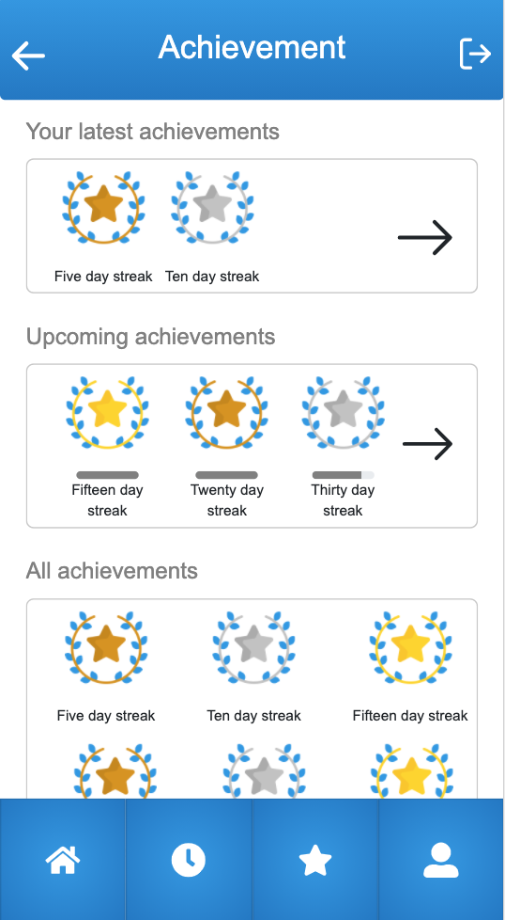
Achievements
Notes:
We have also implemented achievements in our product. Today they are all related to the streak, but in the future it is possible to implement other kinds of achievements. For example achievements related to activity, blood sugar or the forest.

Slide 14
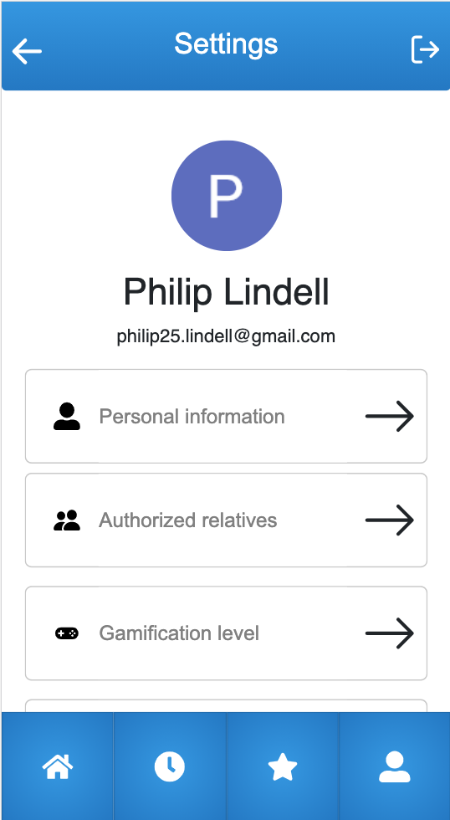
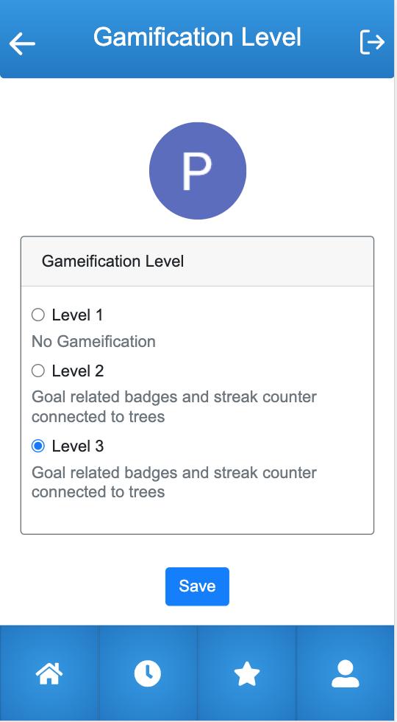
Settings
Notes:
Lastly we have a view where the patient can change settings and get some information on how the app works. Today the only setting that is implemented is the gamification level.

Slide 15
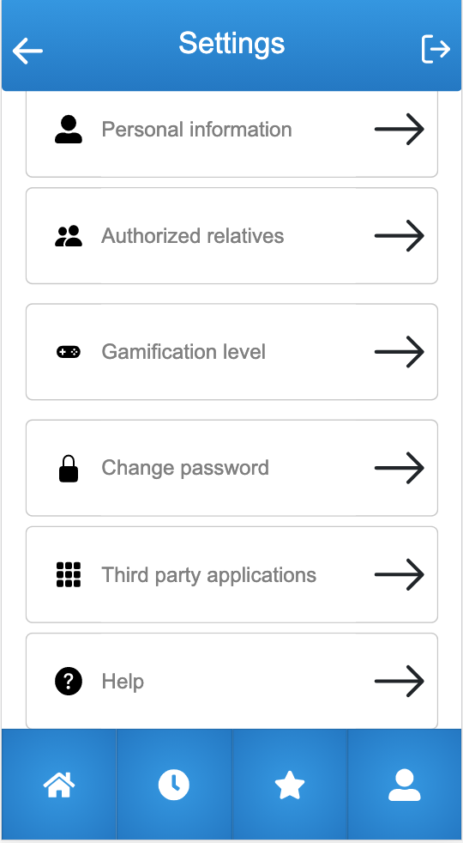
Future
From Rest-list:
Develop the pages in settings
Notifications
Initial guide/tutorial
Graph functionality
Development needed for commercialisation
Authentication
Database
Support for health care professionals
Ideas for the future
Extended gamification
Additional 3rd party apps
Rewards
Integrated communication between medical staff and patients
Notes:
So what can be done with this product in the future. We have created a document for you with information about the functionality that is left to be implemented from our initial idea, information about which development we think is necessary for commercialisation and also ideas for the future.
If we start with what we have left. When creating our product we thought about notifications to both the patient and the patients dependants. We thought that this could help them with not forgetting measurements. We also thought about an initial guide for our prototype. When we had our UX-tests they showed that som econcepts, for example streaks, can be hard to understand for the user. We then tested to add a guide which provided information about some of the concepts and that guide led to increased usability.Therefore we wanted to add a tutorial like that to our product to make it more usable. Lastly we have some functionality that has not been implemented as well as some views, for example the ones in settings.
We have also thought about what we think is left for commercialisation. For example we think that the authentication must be changed to the authentication that is used by Region Östergötland, we need to create a database which can store the game-elements, and we need to add support for the health-care proffessionals so that they for example can add goals to patients.
Lastly we have some ideas for the future. We think that the forest can be developed further with more trees, other kinds of plants for example flowers and also seasons. Moreover we think that more 3rd party apps can be integrated for example Apple health, pokemon go and geocaching. We also see the possibility for the app to have different kinds of rewards. For example there could be a possibility for the patient to sell their trees in the app and then send money to science or charity. Another idea could be for the patients to get flower seeds when a flower is fully grown. The possibilities are endless. The last implementation we think could be beneficial for both patients and medical professionals could be an integrated communication in the app between the two.

Slide 16
Questions?
Notes:
Thank you for your time! If you have some questions about the product, feel free to ask us now. We are also going to invite some more members from our team now so that you can get answers from the technical professionals as well!

